Slide 1

DocSpot: Seamless Appointment Booking
DocSpot is revolutionizing healthcare appointment scheduling, connecting patients and providers effortlessly. Our platform is designed to boost clinic efficiency by an impressive 30%, making healthcare more accessible and manageable for everyone involved.

Slide 2





The Frustration of Current Booking Systems
High Phone Reliance
56% of patients still book via phone calls, leading to significant bottlenecks and delays in accessing care.
Long Wait Times
Patients face an average hold time of 10-15 minutes for appointments, a major source of frustration.
Call Abandonment
1 in 5 patients abandon calls due to excessive wait times, missing out on crucial medical care.
Lost Revenue
An estimated $150 billion is lost annually from missed appointments, impacting both patients and providers.

Slide 3

Introducing DocSpot: The Future of Appointments
DocSpot is an AI-powered, cloud-native scheduling platform designed to transform healthcare accessibility. We offer 24/7 access for patients, clinics, and telehealth providers, ensuring flexibility and convenience.
Our innovative solution significantly reduces administrative burden by 40%, freeing up valuable staff time to focus on patient care. DocSpot is built on a robust, secure infrastructure, prioritizing patient data privacy and compliance.

Slide 4
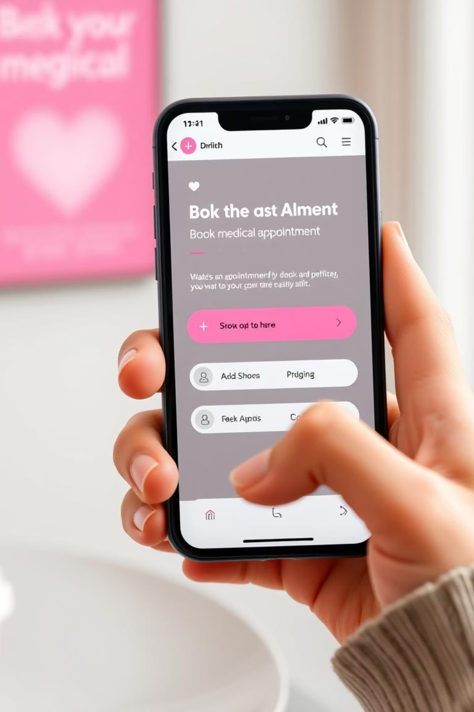
For Patients: Effortless Experience
Rapid Booking
Book appointments in less than 60 seconds, streamlining the entire process.
Extensive Provider Network
Access real-time availability for over 50,000 providers, ensuring diverse choices.
Automated Reminders
Receive automated reminders via SMS/email with an 80% open rate, reducing no-shows.
Flexible Management
Enjoy one-click rescheduling and cancellation options, providing unparalleled convenience.

Slide 5
For Clinics: Optimized Operations
DocSpot empowers clinics to streamline their operations, leading to significant improvements:
Reduces no-show rates by up to 25%, ensuring more efficient use of resources.
Automates patient intake and eligibility checks, cutting down on manual paperwork.
Integrates seamlessly with over 15 major EHR systems, including Epic and Cerner, for a unified workflow.
Saves staff 5-10 hours weekly on scheduling tasks, allowing them to focus on patient care.

Slide 6





The Intelligent Engine Behind DocSpot
Proprietary AI
Data Security
Our AI engine optimizes provider schedules, maximizing efficiency and minimizing downtime.
HIPAA-compliant data security and privacy protocols ensure patient information is always protected.
Scalable Infrastructure
Predictive Analytics
Built on scalable cloud infrastructure with 99.9% uptime, guaranteeing reliability.
Predictive analytics identifies peak demand times, allowing for proactive resource allocation.

Slide 7
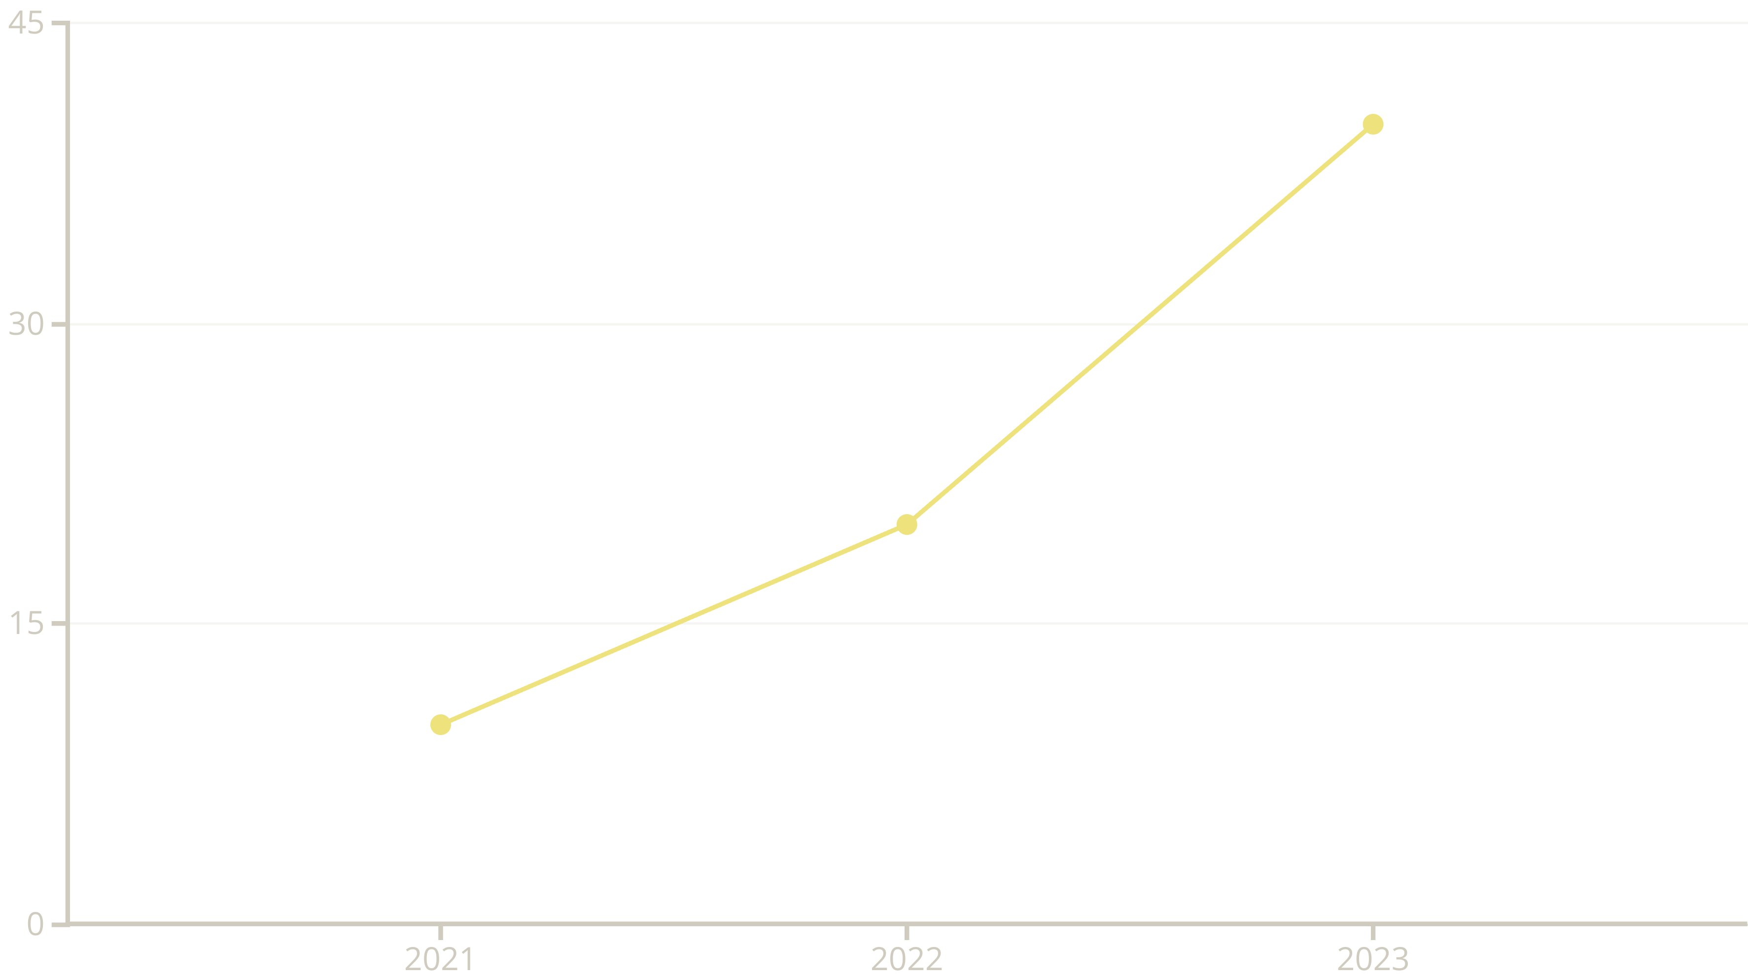
Market Impact & Opportunity
The US market for healthcare IT solutions is a robust $10 billion opportunity. Online booking adoption has seen phenomenal growth, increasing by 300% in just three years. DocSpot aims to capture a significant share of this market, targeting 10,000 clinics by the end of 2025, serving a projected 50 million unique patients.

Slide 8

Our Competitive Edge
Unmatched AI Optimization
Our proprietary AI-driven optimization algorithms provide unparalleled scheduling efficiency and accuracy, setting us apart from competitors.
Deep Integration Capabilities
We offer deep integration capabilities across various healthcare ecosystems, ensuring seamless connectivity with existing systems like EHRs.
Superior User Experience
Patients report a 92% satisfaction rate, highlighting our commitment to an intuitive and user-friendly platform.
Dedicated Support
We provide dedicated 24/7 technical support and comprehensive training, ensuring our clients maximize their investment.

Slide 9

Proven Success: Case Study
Willow Creek Medical Group, a clinic serving 2,500 patients monthly, implemented DocSpot and experienced significant improvements:
Reduced phone calls by 60% within six months, freeing up administrative staff.
Increased appointment conversion by 18%, leading to more booked patient visits.
Decreased no-show rates from 12% to a remarkable 7%, optimizing clinic schedules.
Realized annual administrative cost savings of $30,000, directly impacting their bottom line.

Slide 10

DocSpot: Connect, Optimize, Grow
DocSpot is committed to transforming healthcare access for millions, making it easier for patients to receive the care they need. We empower clinics with unparalleled efficiency and insightful data, allowing them to focus on what matters most: patient well-being.
Invest in DocSpot today and be a part of the seamless future of healthcare.

